Slide 1

RepoLens AI
Recruiter-Style GitHub Repository Evaluation
Transforming GitHub repositories from code storage into career-launching portfolios through intelligent, recruiter-focused analysis.

Slide 2

The Student Portfolio Problem
The Blind Spot
The Metric Trap
Students upload GitHub projects without understanding what recruiters actually look for. They assume code quality alone matters, missing critical presentation elements.
Existing tools show stars, commits, and language breakdowns—but these numbers don't translate to hiring decisions. No clear verdict means no direction.
No Clear Readiness Verdict
Students can't tell if their repository would impress or disappoint a hiring manager
Missing Prioritization
Without guidance on what to fix first, improvements feel overwhelming and scattered

Slide 3





Why Current Solutions Miss the Mark
Metrics Without Meaning
No Strategic Focus
Tools report numbers but don't explain how recruiters interpret them. A repository with 100 commits might still fail screening.
All weaknesses treated equally means students waste time on minor issues while critical problems remain unaddressed.
Zero Actionable Guidance
Industry Disconnect
Identifying problems without solutions leaves developers stuck, unable to bridge the gap between current state and recruiter expectations.
Students remain unaware of real-world hiring criteria, continuing to build portfolios that don't align with professional standards.

Slide 4
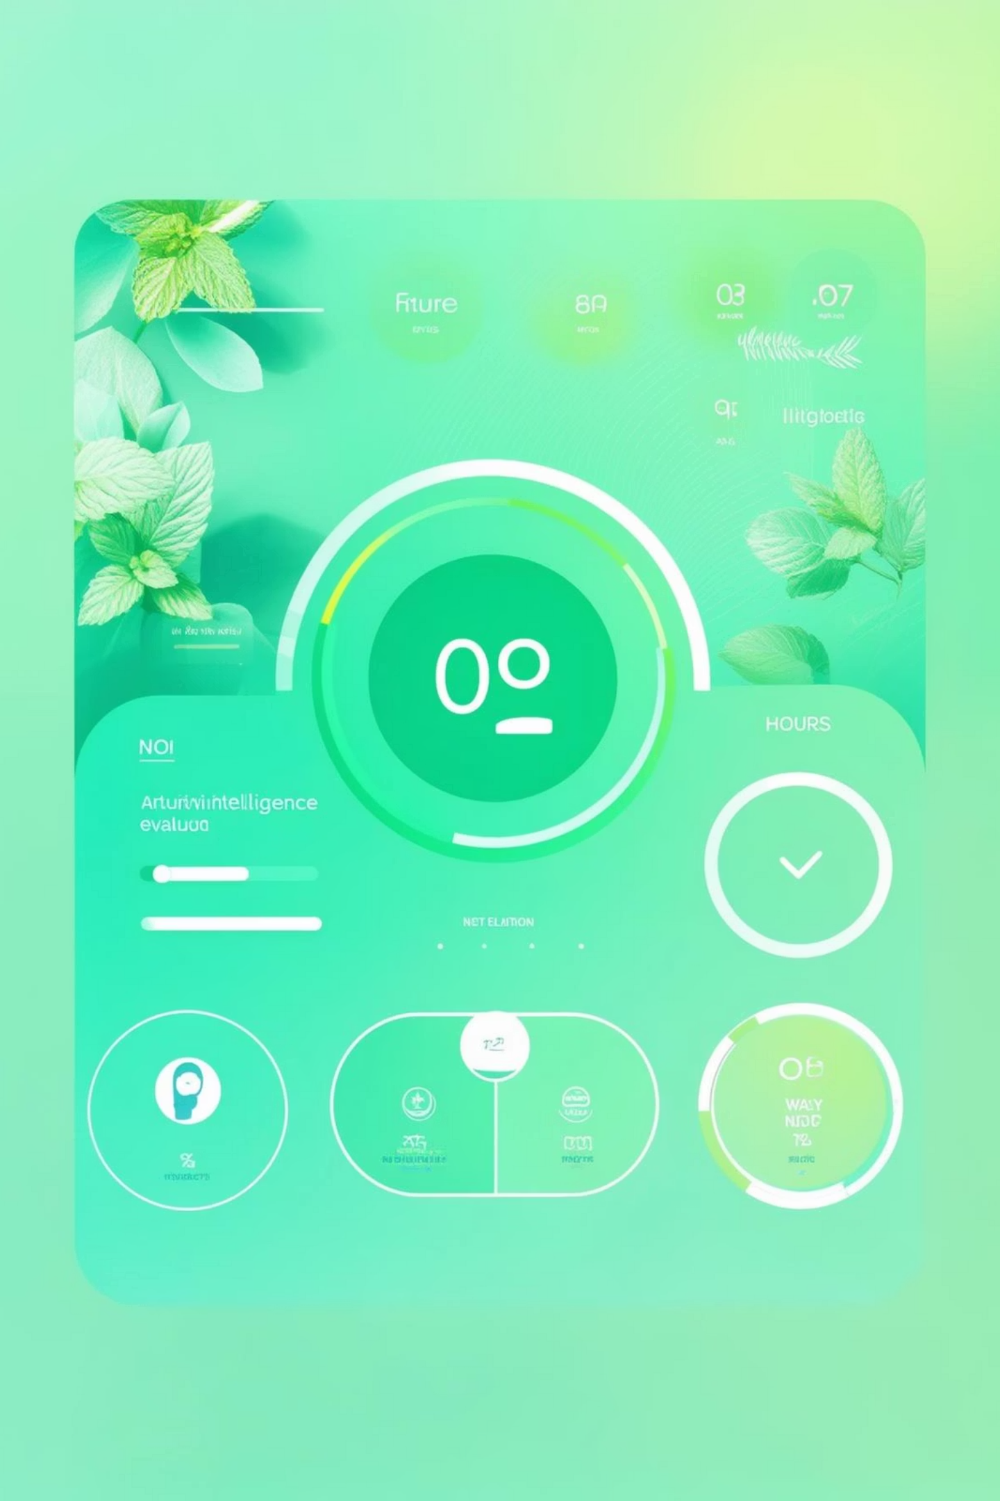

RepoLens AI: The Core Innovation
Recruiter Mindset, Not Just Analysis
RepoLens evaluates repositories through the lens of hiring managers, asking "Would I interview this candidate?" rather than just counting metrics.
Clear Binary Verdict
Every repository receives a definitive assessment: Production Ready or Needs Improvement. No ambiguity, just clarity on where you stand.
Critical Weakness Identification
The system highlights the specific issues that would cause recruiters to pass on your profile, focusing on deal-breakers rather than nice-to-haves.
Prioritized Action Plan
Get exact guidance on what to fix first, with explanations of why each improvement matters to hiring decisions.

Slide 5

What Sets RepoLens Apart
"Most tools show metrics. RepoLens acts like a recruiter."
The fundamental difference: RepoLens doesn't just measure—it judges. It gives verdicts, highlights critical weaknesses, and provides exact fix-first instructions.
While other platforms focus on what exists, RepoLens focuses on what matters for landing interviews and job offers.
Decisions Over Data
Context Over Counts
Strategy Over Statistics
Actionable verdicts that directly translate to career outcomes
Understanding why numbers matter in recruitment contexts
Prioritized improvements aligned with hiring priorities

Slide 6



Education Before Evaluation
01
Learn Recruiter Expectations
Before evaluation, RepoLens teaches students exactly what hiring managers look for in GitHub portfolios.
02
Build With Guidance
Interactive tutorials guide users through creating recruiter-ready projects from the ground up.
03
Evaluate With Confidence
Armed with knowledge, students can self-assess and iterate before final evaluation.
04
Avoid Common Pitfalls
Proactive education reduces portfolio rejection rates by addressing issues before they become problems.
Impact: Students who complete the educational modules before evaluation show 73% fewer critical weaknesses in their initial assessments.

Slide 7
Five Dimensions of Evaluation
README Quality & Documentation
Project Structure & Organization
Commit History & Consistency
Testing Practices & CI/CD
Clarity of project explanation, setup instructions, and feature descriptions that help recruiters quickly understand your work.
Logical file hierarchy, separation of concerns, and professional naming conventions that demonstrate architectural thinking.
Meaningful commit messages, regular contribution patterns, and clear development progression showing sustained effort.
Automated test coverage, continuous integration setup, and deployment pipelines indicating production-grade development habits.
Code Depth & Maintainability
Implementation quality, code readability, commenting practices, and architectural decisions that reflect professional standards.

Slide 8



Common Repository Vulnerabilities
Based on analysis of thousands of student portfolios, these critical weaknesses repeatedly trigger recruiter rejection:
1
2
3
Missing or Weak README
No or Poor Test Coverage
Single Large or Inconsistent Commits
The #1 portfolio killer. Without a clear README, recruiters can't quickly assess your project's value or complexity. Many close the tab within 30 seconds.
Absence of tests signals inexperience with professional development practices. Recruiters question if you understand production-ready code.
Commit history reveals work habits. One massive commit suggests poor version control practices or academic project submission mindset.
4
5
No CI/CD Pipeline Configured
Unstructured Folders & Unused Code
Modern development requires automation. Missing pipelines indicate unfamiliarity with DevOps fundamentals expected in most roles.
Disorganized repositories with commented-out code, unused files, or flat folder structures reveal lack of architectural planning and maintenance.

Slide 9




Fix First & Improvement Roadmap
Intelligent Prioritization
Personalized Action Plans
RepoLens analyzes all weaknesses but highlights high-impact issues first—the changes that will most dramatically improve recruiter perception.
Every repository receives a custom improvement roadmap with:
Specific issues ranked by priority
Step-by-step implementation guidance
Not all fixes are equal. A compelling README has 10x more impact than fixing minor code style issues.
Expected time investment per fix
Examples of successful implementations
Current State
Needs Improvement verdict with identified weaknesses
Targeted Fixes
Address critical issues following prioritized roadmap
Production Ready
Achieve recruiter-ready status with confidence

Slide 10

Bridging Students and Recruiters
85%
3.2x
47%
Improved First Impressions
Interview Conversion
Time Saved
Faster portfolio improvements through prioritized, focused guidance
Portfolios receive higher recruiter engagement after RepoLens optimization
Users report significant increases in technical interview invitations
From Code Dump to Career Asset
Education Meets Evaluation
RepoLens transforms GitHub from a simple code storage platform into a powerful portfolio that actively advances your career prospects.
By combining teaching with assessment, RepoLens creates developers who understand professional standards and know how to meet them.

